Slide 1
PROBLEM

Slide 2
Definition
A neural network with just one layer
A loss function (Mean Squared Error (MSE))
One neuron, numerous weights w₁, w₂, w₃…, a bias b
A ReLU activation
Knowing our network and our loss function, how can we tweak the weights and biases to minimize the loss?
2

Slide 3
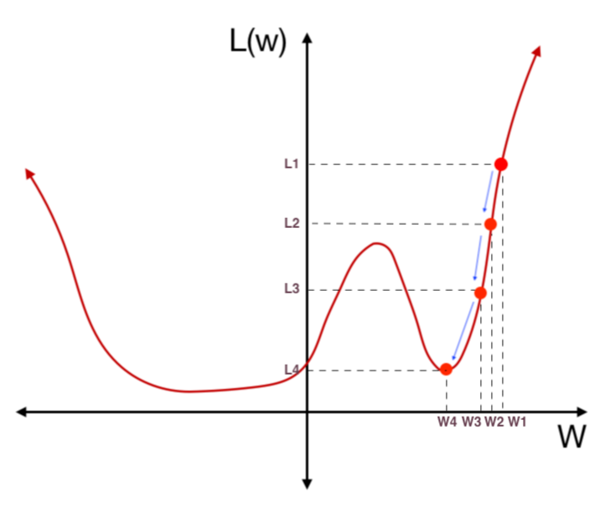
Minimize the loss Using gradient Descent

Slide 4
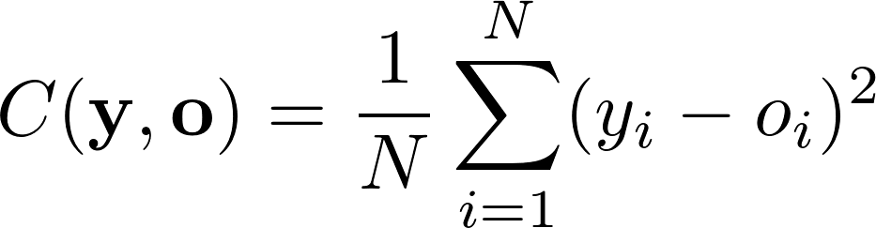
1- What is the Loss (cost) Function …(MSE)
MSE squares the difference between every network output (o) and true label (y), and takes the average
4

Slide 5
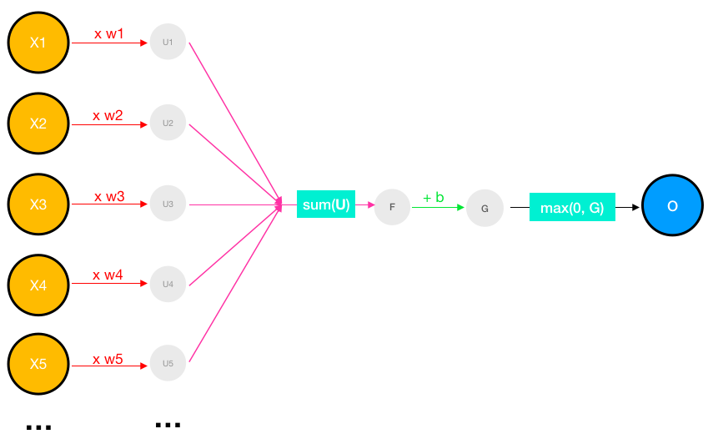
2- What is the activation function used?
A ReLU is simply a function that converts any negative values to 0. Let’s rename that as the max(0,z) function, which returns z if z is positive and 0 if z is negative.
activation(x) = max(0, w ∙ x + b)
activation(z) = max(0, z)
5

Slide 6
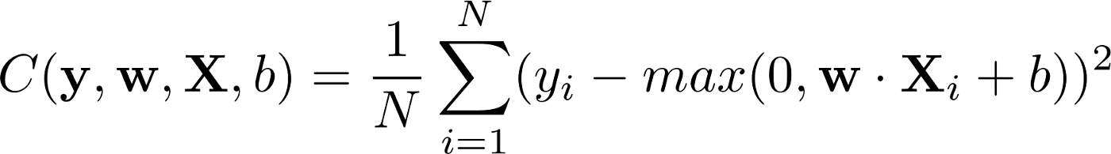
➔The loss function
Capital X (is a vector of input)
What is the slope of the loss function?
6

Slide 7
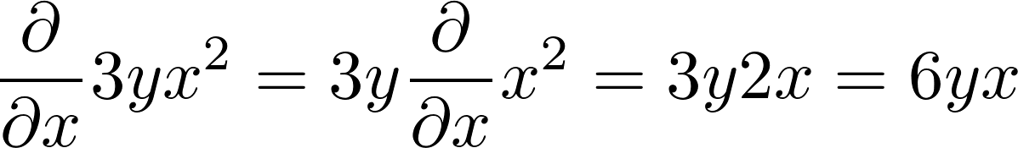
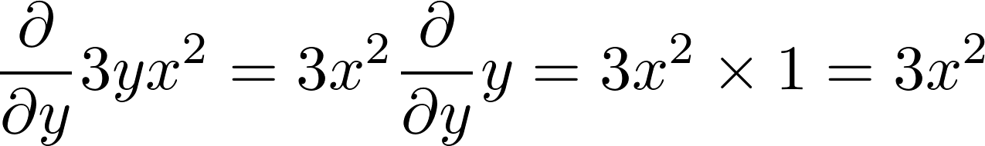
Slope is the derivative of the loss function
With respect to weights w₁, w₂, w₃…, and bias b
Partial derivative example for f(x,y) = 3x²y.
7

Slide 8
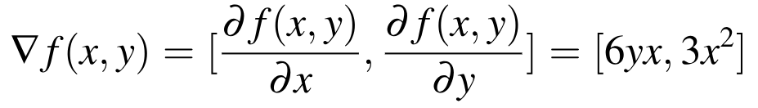
The gradient of the function f(x,y) = 3x²y
is a horizontal vector, composed of the two partials:
the gradient of the function in the x-direction,
the gradient of the function in the y-direction,
8

Slide 9
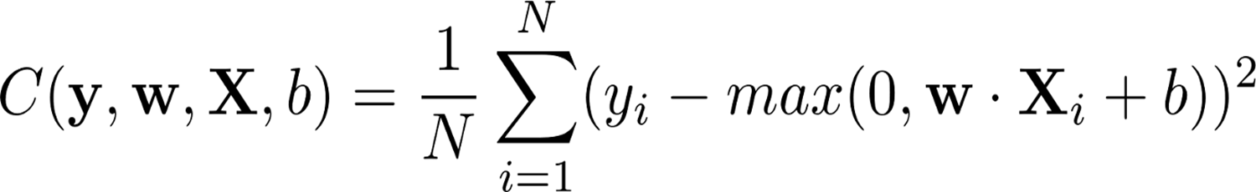
How can we compute the partial derivatives of vector equations?

Slide 10
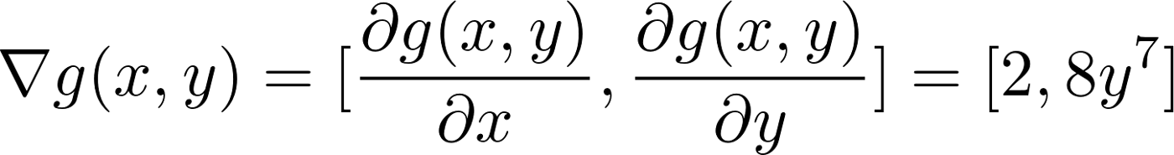
The gradient of the function g(x,y) = 2x+y⁸
is a horizontal vector, composed of the two partials:
the gradient of the function in the x-direction,
the gradient of the function in the y-direction,
10

Slide 11
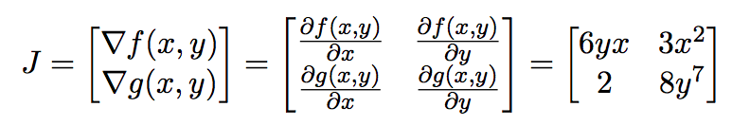
Gradient of a Vector Function :Jacobian Matrix
A neural network with just one layer
A loss function (Mean Squared Error (MSE))
One neuron, nuerous weights w₁, w₂, w₃…, a bias b
A ReLU activation
11

Slide 12
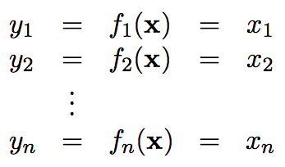
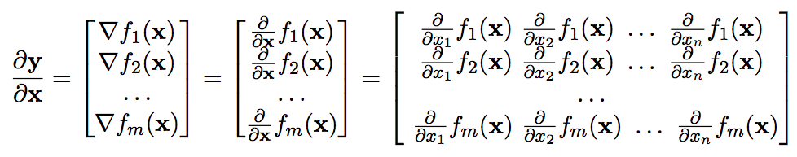
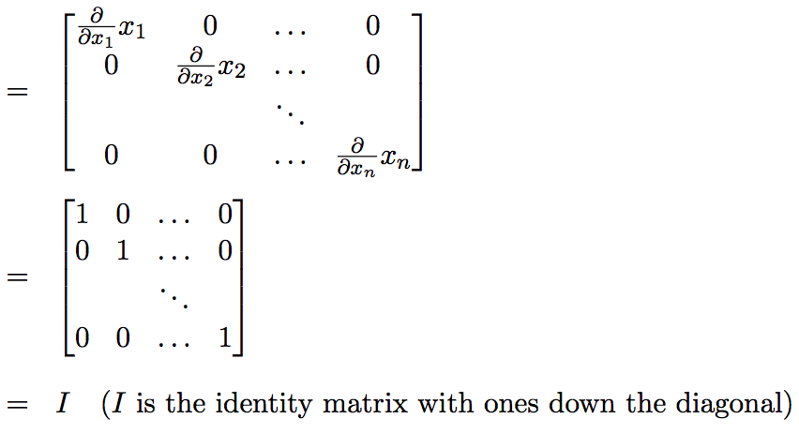
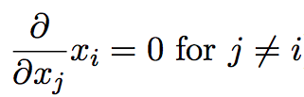
Gradient of the identity function f(x) =x
12

Slide 13



Gradient of vector sum
since the partial derivative of a function with respect to a variable that’s not in the function is zero, it can be further simplified as:
13

Slide 14

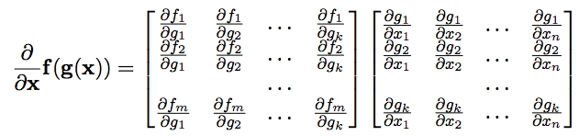
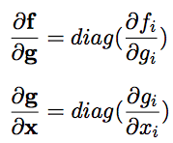
Vector chain rule
Since, each function f matches with
exactly 1 function g

Slide 15

What is the Gradient of A Neuron?

Slide 16

let f(x)=w∙x+b, and g(x)=max(0,x)then
neuron(x)=g(f(x)). (Apply activation function)
➔ use the vector chain rule to find the derivative of this composition of functions
z=f(x)=w∙x+b

Slide 17




What is the partial derivative of z with respect to w? (v=w .x and u=sum(v) 1- derivative of wx 2- derivative of b
17

Slide 18
What is the partial derivative of z with respect to w? (v=w .x and u=sum(v) 1- derivative of wx 2- derivative of b
18

Slide 19
What is the partial derivative of z with respect to w? (v=w .x and u=sum(v) 1- derivative of wx 2- derivative of b
19

Slide 20


What is the partial derivative of z z= u+b
20

Slide 21
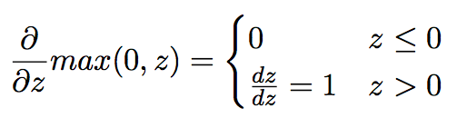
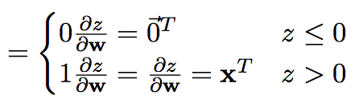
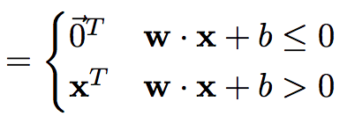
What is the partial derivative of neuron(z) with respect to z?
Neuron(z)=max(0,z)=max(0, sum(w⊗x)+b).
21

Slide 22
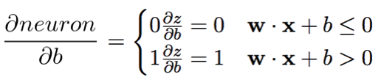
What is the partial derivative of neuron(z) with respect to b?

Slide 23
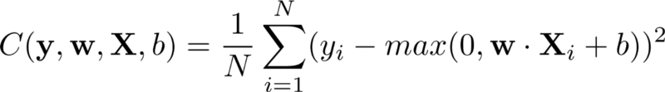
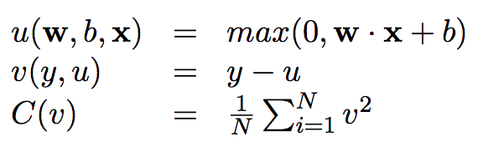
Gradient of Loss Function

Slide 24
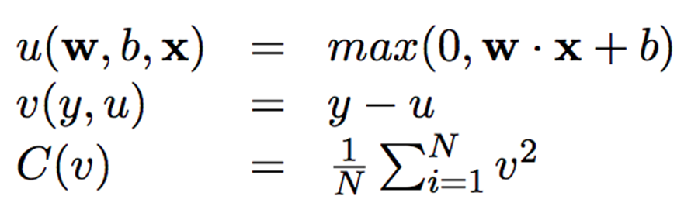
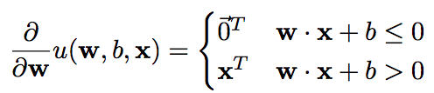
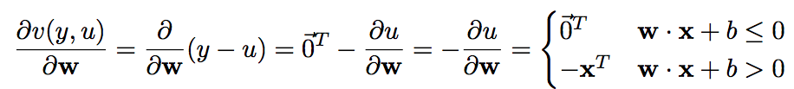

Gradient With Respect to Weights

Slide 25
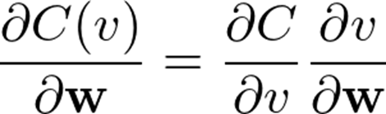
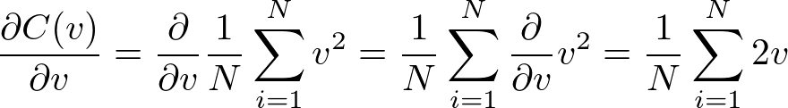
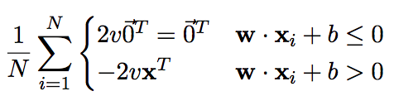
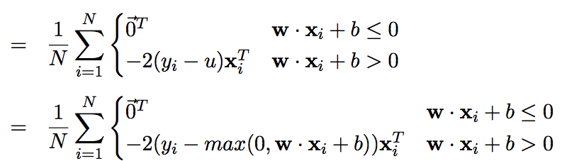

Slide 26
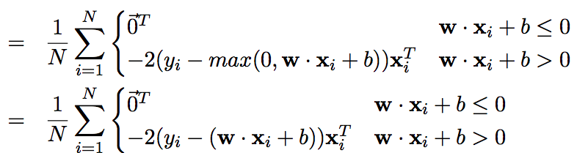
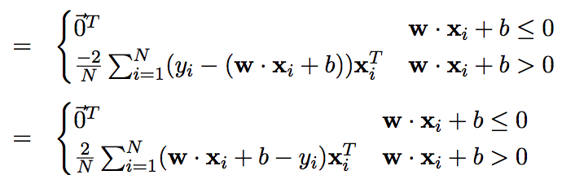
This is the derivative of the loss function

Slide 27
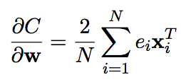
What does it mean ?
ei= w∙x+b-y can be interpreted as an error term
The derivative represents the slope (how much we must move our weights by in order to minimize our error)
If our neural network has just begun training, and has a very low accuracy, the error will be high and thus the derivative will be large as well. Therefore, we will have to take a big step in order to minimize our error.

Slide 28

Subtract current weights with the derivative in order to get one step closer to minimizing the loss function
η represents the learning rate➔The larger the learning rate, the bigger the step

Slide 29
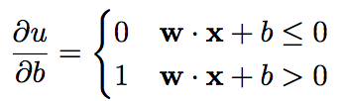
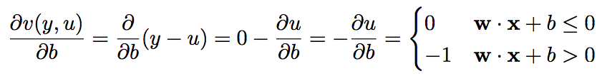

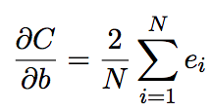

Gradient With Respect to bias

